Slide 1
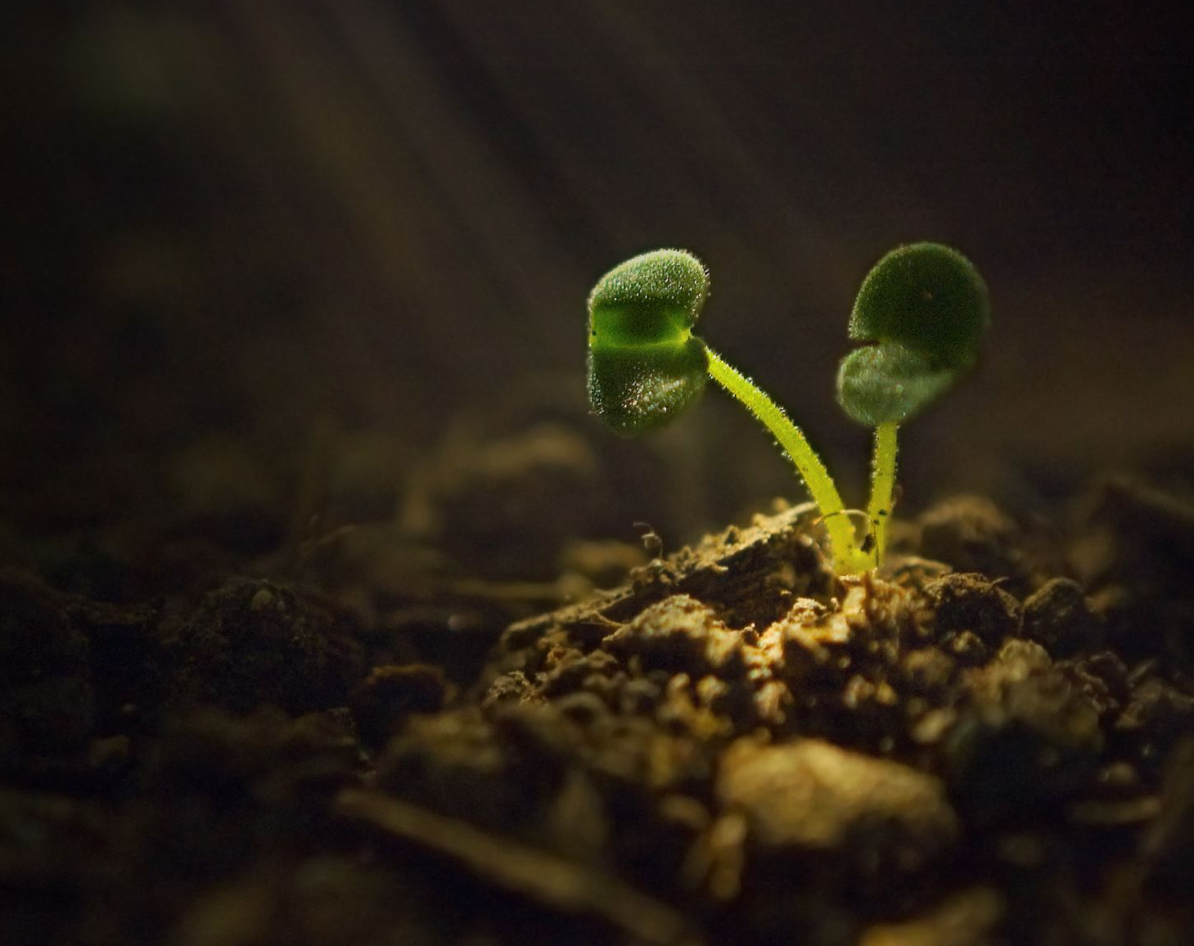
Plant Seedlings Classification Using Deep Learning
Team ID No. 32
Selected Topics in Cs - 2

Slide 2
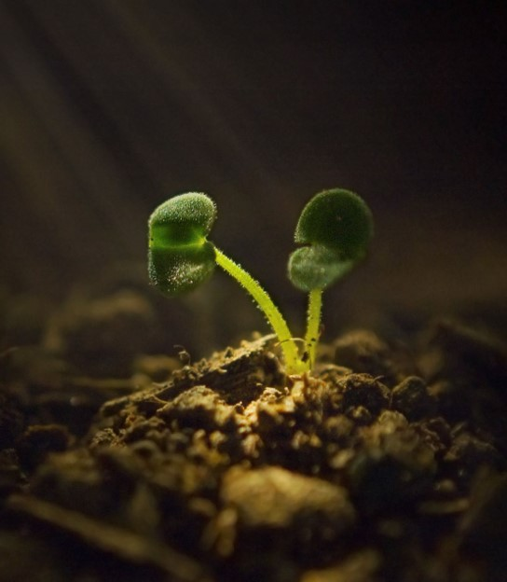
Implementation Details:
Model Architecture Used in Paper:
Input images pre-processed by:
1- Normalizing the pixel values to a [0,1] range.
2- Data was augmented via several random transformations. The selected data augmentation techniques were (size re-scaling, rotations of 40, horizontal shift, image zooming, and horizontal flipping).
3- Resizing the image shape to 224x224 pixel.
Initialize MobileNetV2 pretrained model with input size (224,224,3).
Adding layers:
1- BatchNormalization.
2- GlobalAveragePooling2D.
3- 2 Dense layers with ‘1024’ and ‘512’ neurons with ‘Relu’ activation function.
4- Dropout (0.5).
5- 1 Dense layer with ‘15’ neuron - based on Number of Classes in dataset - with 00‘SoftMax’ activation function.
Input Images Pre-processed by:
1- Normalizing the pixel values to a [0,1] range.
2- Data was augmented via several random transformations. The selected data augmentation techniques were (size re-scaling, rotations of 40, horizontal shift, image zooming, and horizontal flipping).
3- Resizing images to 128x128 pixel.
Then VGG16 was used to train the model.
Data was divided into training (90%), validation (10%).
Results:
The Training accuracy was 100%
The Validation accuracy was 99.48%

Slide 3
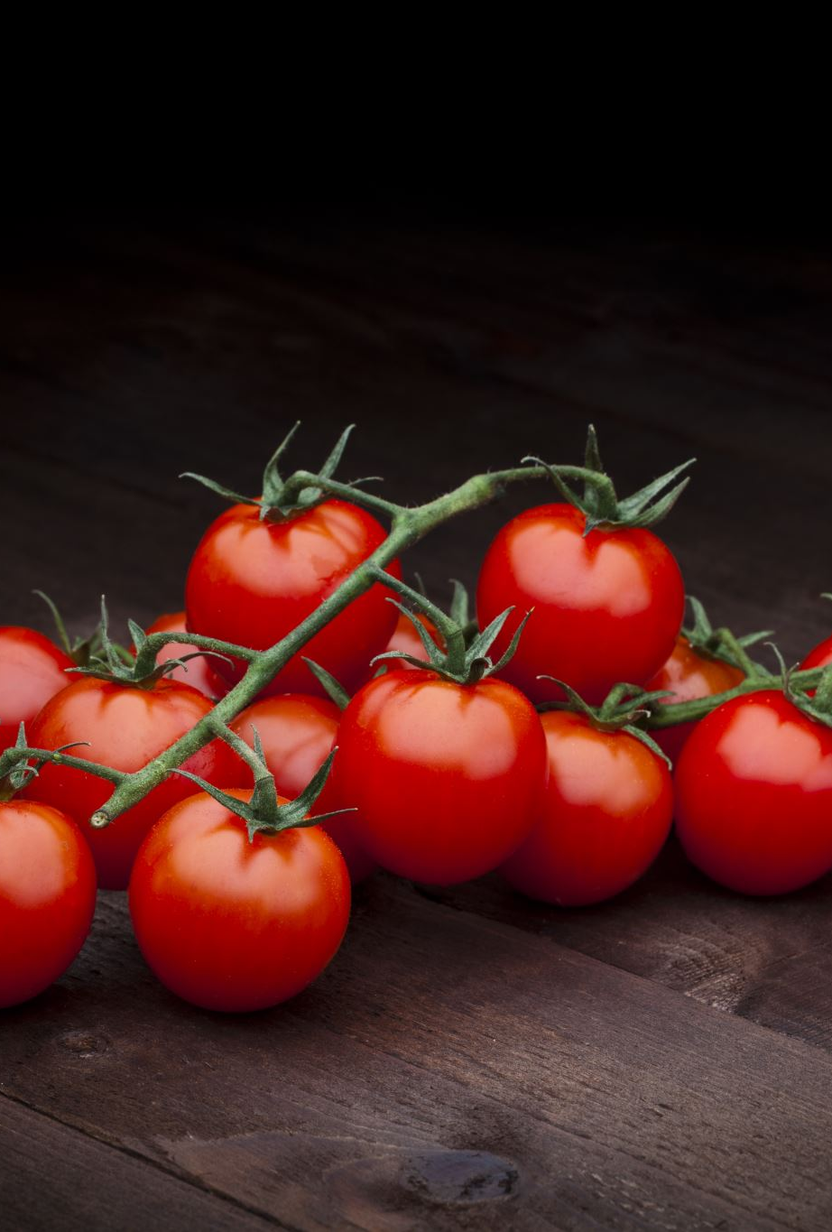
Dataset Details:
The dataset contains different healthy and unhealthy crop leaves. It is recreated using augmentation from the original dataset. Total number of images we have 20638 RGB images of healthy and diseased crop leaves which is categorized into 15 different classes.
The total dataset is divided into 80% 10% 10% ratio of training, validation and test.
Plant Village Classes (15 Class):
Pepper bell Bacterial spot (997)
Pepper bell healthy (1478)
Potato Early blight (1000)
Potato Late blight (1000)
Potato healthy (152)
Tomato Bacterial spot (2172)
Tomato Early blight (1000)
Tomato Late blight (1909)
Tomato Leaf Mold (952)
Tomato Septoria leaf spot (1771)
Tomato Spider mites Two spotted spider mite (1676)
Tomato Target Spot (1404)
Tomato Tomato Yellow Leaf Curl Virus (3209)
Tomato Tomato mosaic virus (373)
Tomato healthy (1591)

Slide 4
Implementation Details:
Input Images Pre-processed by:
1- Normalizing the pixel values to a [0,1] range.
2- Data augmentation techniques as specified in paper.
3- Resizing images to 224x224 pixel.
We split the dataset into 80% 10% 10% ratio of training (16505), validation (2057) and test (2076).
Initialize MobileNetV2 pre-trained model with input size (224,224,3).
Adding Layers:
BatchNormalization.
GlobalAveragePooling2D.
2 Dense layers with ‘1024’ and ‘512’ neurons with ‘Relu’ activation function.
Dropout (0.5).
1 Dense layer with ‘15’ neuron - based on Number of Classes in dataset - with ‘SoftMax’ activation function.
Setting Minimum Learning Rate to ‘0.0001’ and Patience to ‘3’.
Then, the model is trained for ‘80’ epochs using ‘Adam’ optimizer and batch size ’64’.

Slide 5
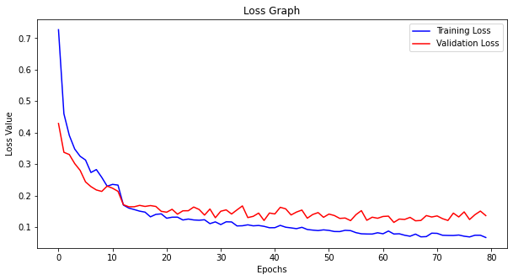
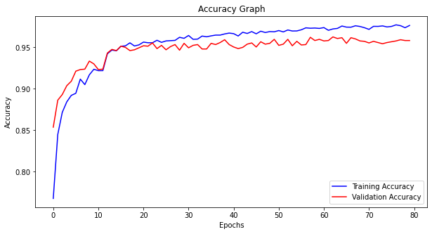
Results and Visualization
Model Accuracy: 0.9706165790557861
Loss: 0.1038

